Slide 1

Welcome and Call to Order: Workshop in Geospatial Methods
Nicolette Baines, Zahra Sayyed & Michael Otterstatter
Sept 17th, 2019

Slide 2

Traditional Territory
We would like to begin by acknowledging that the land on which we gather is the traditional territories of the Blackfoot and the people of the Treaty 7 region in Southern Alberta, which includes the Siksika, the Piikuni, the Kainai, the Tsuut’ina and the Stoney Nakoda First Nations, including Chiniki, Bearpaw, and Wesley First Nations. The City of Calgary is also home to Métis Nation of Alberta, Region III. I am a settler/visitor/ally and make this acknowledgment to promote reconciliation.
Notes:
I would like to take this opportunity to acknowledge the traditional territories of the Blackfoot and the people of the Treaty 7 region in Southern Alberta, which includes the Siksika, the Piikuni, the Kainai, the Tsuut’ina and the Stoney Nakoda First Nations, including Chiniki, Bearpaw, and Wesley First Nations. The City of Calgary is also home to Métis Nation of Alberta, Region III. I am a settler/visitor/ally and make this acknowledgment to promote reconciliation. Siksika (sik-sik-a) → little faster .. Sounds like a t a bit Piikuni (pee-gun-nee) → pee gun nee … emphasize the “un” part Kainai (kye-nye) → Tsuut’ina (soot-ina) Chiniki (chin-i-kee)

Slide 3
Housekeeping Items
Washroom Locations
Wi-Fi Information
Please put your cellphones and other devices on silent or vibrate

Slide 4
Working Assumptions
The group will trust and work with the collective wisdom they have ​
There are no bad questions or wrong answers ​
The whole is greater than the sum of its parts ​
Everyone will be heard and will hear others

Slide 5
Canadian Partnership Against Cancer

Slide 6
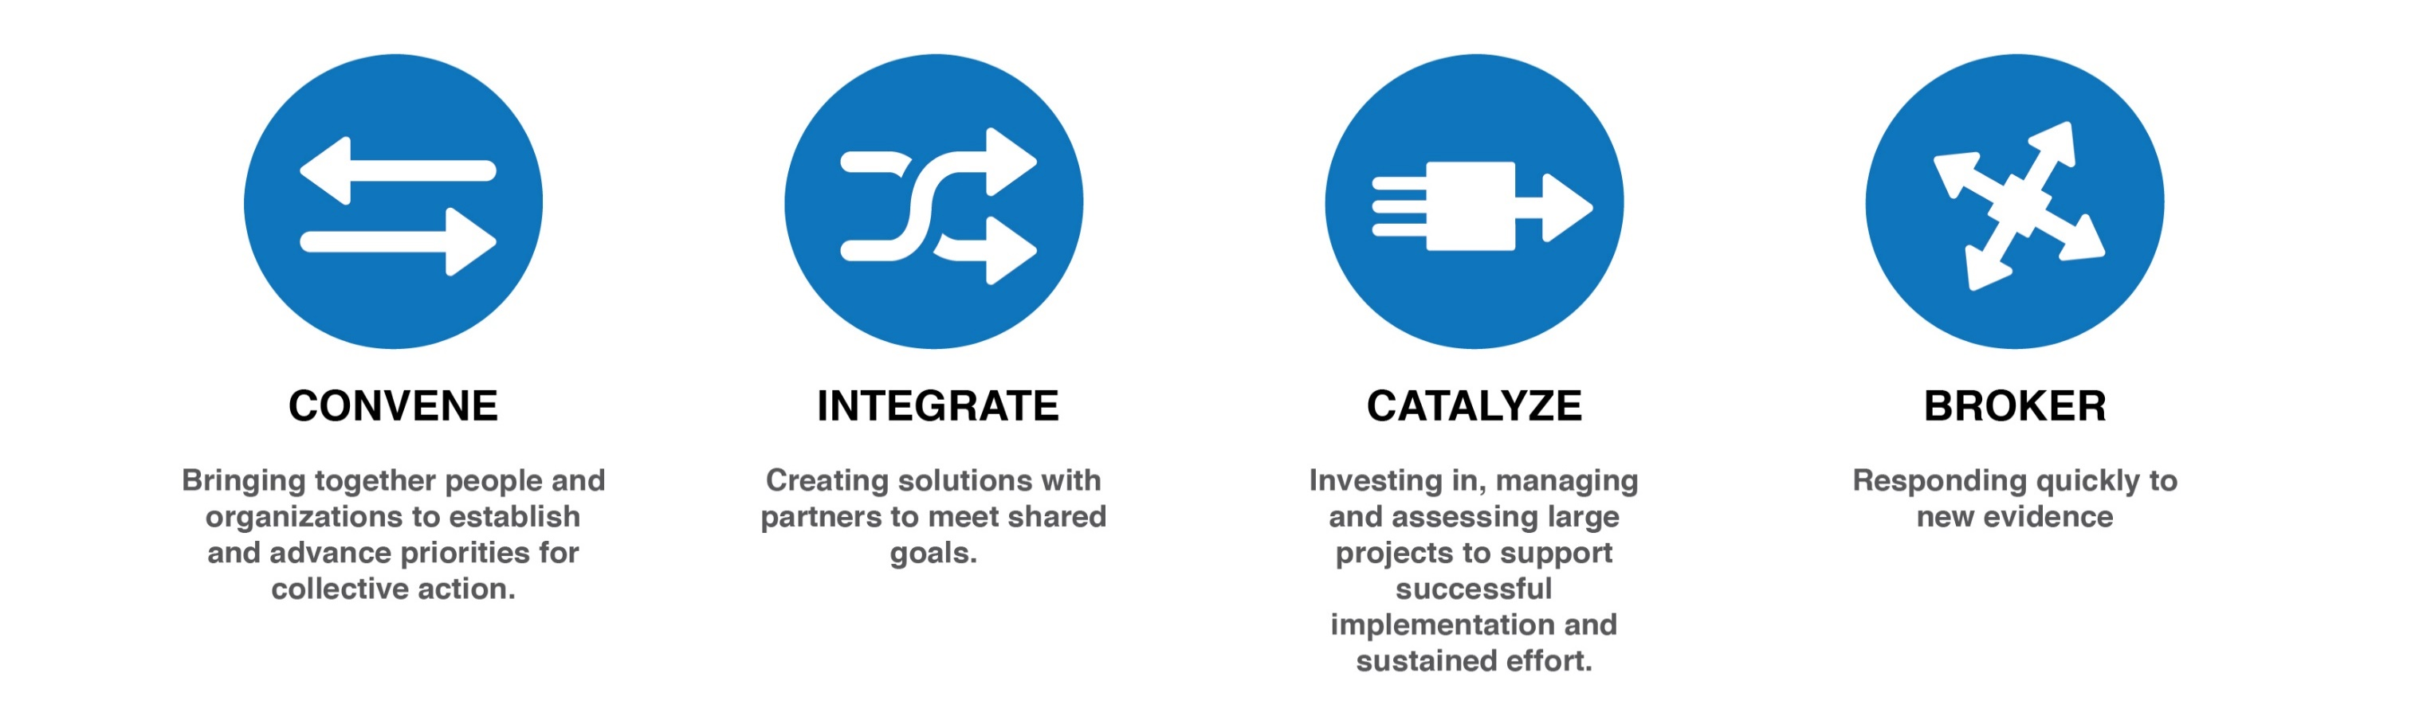

Canadian Partnership Against Cancer
CONVENE
Bringing together people and organizations to establish and advance priorities for collective action
INTEGRATE
Creating solutions with partners to meet shared goals
CATALYZE
Investing in, managing and assessing large projects to support successful implementation and sustained effort
BROKER
Responding quickly to new evidence
Notes:
Background - CPAC
The Canadian Partnership Against Cancer is an independent organization funded by the federal government to accelerate action on cancer control for all Canadians
Our goal is to translate what we have learned about the successes and barriers to change, into pervasive and impactful front-line policy and practice across Canada for the benefit of all cancer patients or those at risk of cancer
Our efforts are collectively focused on the long-term objectives of reducing the incidence of cancer, reducing the likelihood of dying from cancer and improving the quality of life of those affected by cancer
Our work spans the continuum of cancer control – from prevention and screening through diagnosis and clinical care to palliative care and survivorship
As the steward of the Canadian Strategy for Cancer Control, our ability to effect change is driven by all of our partnerships
Ten years of shared effort has yielded results and key learnings related to effecting systemic change through unique modes of collaboration and improving the experience for Canadians with cancer and their families
Central to this effort is influencing health system administrative structures and policies to meaningfully create systemic clinician behaviour change that measurably supports patient and family needs
References
Canadian Partnership Against Cancer – Our Mandate: https://www.partnershipagainstcancer.ca/about-us/our-mandate/

Slide 7
Canadian Strategy for Cancer Control (2019-2029)

Slide 8









Canadian Strategy for Cancer Control
CANADA HAS MADE MUCH PROGRESS
Canadian Strategy for Cancer Control developed by 700 cancer patients and professionals
2006
2007-2017
2007
Canadian Partnership Against Cancer created by the Federal government to coordinate implementation
Cancer researchers have access to health data from over 300,000 Canadians.
First Nations, Inuit and Métis communities have a cancer action plan.
Colorectal cancer screening programs are in place or planned in all provinces and one territory.
A national database with standard collection of patient data allows us to study trends and patterns.
Strategies and supports are in place across the country to help cancer patients reduce or quit smoking.
Investigator-led clinical trials and patients participating in clinical trials have significantly increased.
Notes:
There is compelling evidence that Canada’s Strategy has resulted in substantial action across the country to improve cancer control. For example:
We now have one of the world’s largest population health studies
Indigenous communities have a cancer action plan with resources improving care for those living in rural, remote and isolated communities
More Canadians are screened for colorectal cancer
We’re able to better identify trends and patterns in cancer care, with standard collection of patient data
We are supporting cancer patients with smoking cessation
More Canadian cancer patients are participating in clinical trials
The refreshed Strategy lays out a bold and modernized vision and a 10-year action plan, setting out priorities and actions so that all Canadians will have access to high-quality cancer care no matter who they are or where they live.
It is designed to address new opportunities and growing pressures, The Strategy will also ensure the health-care system remains sustainable into the future. Above all, it reflects the voices and priorities of Canadians.

Slide 9
Channels of input to provide feedback into the Refresh of the Canadian Strategy for Cancer Control
6500
Online ChoiceBook Submissions
24
Online Sub-missions
175
In-person Community Sessions
610
Program and Partner led Meetings
General Public
From organizations
Underserved Populations
General Public Pop-Up Sessions
In person
Online
Patient voice
Indigenous engagement
Notes:
To refresh the Strategy, the Partnership led an extensive engagement process over the past year that reached across the country, gathering input from more than 7,500 cancer patients, health care providers, policy makers, health system leaders and the public.
You will recall that this network was engaged and I hope you are as excited by the new strategy as I am and see alignment with your own organizational priorities and projects.

Slide 10

The Role of The Steward
Setting a shared vision through a refreshed strategy for cancer control
Establishing bold targets and reporting to Canadians on collective progress
Driving shared action and supporting aligned activities
Notes:
The refreshed Strategy clearly calls for the role of the Partnership to continue as steward. This is what Canadians expect.
As the Strategy changes so will our role as steward:
Time to call others to action
No one organization has all the authority, resources or skills to impact the Strategy goals alone, including the Partnership
We’ll bring partners – some new ones – together to deliver the Strategy
It takes working together in uncommon ways to deliver on Canadians’ top priorities for cancer
It will require the contributions, expertise and resources of organizations across the country and our PCHO partners

Slide 11





Priority Areas
Decrease the risk of people getting cancer
Diagnose cancer faster, accurately and at an earlier stage
Deliver high-quality care in a sustainable, world class system
Eliminate barriers to people getting the care they need
Deliver information and supports for people living with cancer, families and caregivers
Notes:
The Strategy focuses on five priorities that address key challenges in prevention, screening, diagnosis, treatment, access, and support to alleviate the burden across the entire cancer journey:
Decrease the risk of people getting cancer
Diagnose cancer faster, accurately and at an earlier stage
Deliver high-quality care in a sustainable, world class system
Eliminate barriers to people getting the care they need
Deliver information and supports for people living with cancer, families and caregivers

Slide 12


Priority 2: Actions
Prioritize rapid access to appropriate diagnosis for those suspected of having cancer.
Strengthen existing screening efforts and implement lung cancer screening programs across Canada.
PRIORITY 2
Diagnose cancer faster, accurately and at an earlier stage

Slide 13



Priority 4: Actions
Provide better services and care adapted to the specific needs of underserviced groups
Ensure rural and remote communities have
the resources required to better serve their people
Ensure care can be delivered between provinces, territories and federal jurisdictions when needed
PRIORITY 4
Eliminate barriers to people getting the care they need

Slide 14



First Nations, Inuit and Métis: 3 Key Cancer Care Priorities
Culturally appropriate care closer to home
Peoples-specific, self-determined cancer care
First Nations, Inuit or Métis-governed research and data systems
Notes:
First Nations, Inuit and Métis governments, organizations and individuals were also engaged in a parallel process to establish Peoples-specific priorities in cancer care.
Three priorities were identified by First Nations, Inuit and Métis. For each of these priorities, Peoples-specific actions were identified that help drive needed changes in outcome and
experience for all First Nations, Inuit and Métis.
This is a first for the Strategy and represents Canada’s commitment to reconciliation.

Slide 15
Three-Pronged Approach

Slide 16
Health Equity: Three-Pronged Approach
Analytic Capacity Building Initiative
Community Engagement EOI
Program Packs
Notes:
The Screening & Early Detection Team → three-pronged approach has been initiated to provide capacity and content supports to provincial/territorial partners (Program Packs, Analytic Capacity Building Initiative & Community Engagement)
It is envisioned that this approach will advance the uptake of colorectal cancer screening and decrease disparities in screening access, ultimately resulting in more Canadians being screened for cancer
Analytic Capacity Building Initiative: Generating Local-Level Data on Underscreened Populations - Building partner capacity with Geographic Information System (GIS) training and tools to generate community-level information to identify underserved populations within their jurisdictions and to overlay, as appropriate, other population health data in order to better understand local level supports and barriers to screening. As a result of this initiative, participants will: a) have an understanding of GIS mapping theory and methodology and the ability to analyze local-level variation in colorectal cancer screening participation, and b) use this information to perform spatial analysis of screening participation and other related indicators to enable targeted action (e.g. utilizing data to support community-level engagement and/or implement interventions to increase participation).
Joint Analytic Project Opportunity
The purpose of the Joint Analytic Project is to use geospatial methods and tools to better understand a key issue in colorectal cancer screening among underscreened populations. This work will provide critical information that can help develop solutions to reduce disparities.
Webinar early Oct → Looking to scope out what key questions in colorectal cancer screening among underscreened populations would be important to better understand and feasible to analyze with the data that is available in your jurisdiction
Developing Strategies for Underscreened Populations through Community Engagement initiative. (proposal deadline: Sept 12th) A funding opportunity that will support jurisdictions to engage selected communities in discussions around the community-level data, to understand the qualitative context for the data, and to draw from the menu of evidence-based approaches in order to develop an approach to increasing participation for CRC screening in that community. While the focus of this EOI is on interventions to increase participation in colorectal cancer screening, the results and outcomes are intended to be applicable to other screening areas.
Program Packs:
Three reports on key factors that are associated with being underscreened (low-income, rural/remote residence and immigration status. These are being developed with the objective of providing quick and easy access to key evidence on disparities and barriers to colorectal cancer screening and effective interventions to increase participation in colorectal cancer screening. These reports aim to improve knowledge about optimal strategies to address disparities in colorectal screening across Canada and inform provincial/territorial government and cancer agency decision-making.
References
Canadian Partnership Against Cancer – Cancer System Performance report (2018): https://www.partnershipagainstcancer.ca/wp-content/uploads/2019/01/2018-Cancer-System-Performance-Report-EN.pdf
Canadian Partnership Against Cancer – Colorectal Screening Monitoring report (Released 2017) - https://www.partnershipagainstcancer.ca/wp-content/uploads/2019/01/Colorectal-Screening-Monitoring-Report-2014-EN.pdf

Slide 17
Roundtable Introductions
Introductions include:​
Name​
Title​
Province/territory/organization

Slide 18
Workshop Instructor
Michael Otterstatter
Senior Scientist at the BC Centre for Disease Control and an Assistant Clinical Professor in the School of Population and Public Health at University of British Columbia
His research and teaching focus on theory and methods for the analysis, modeling and visualization of health data
He holds a doctorate from the University of Toronto, as well as MSc and BSc degrees from the University of Calgary
Previously, Dr. Otterstatter worked in cancer surveillance with the Public Health Agency of Canada in Ottawa

Slide 19
Workshop Technical Support
Aidan Ablona
Data Analyst with Clinical Prevention Services at the BC Centre for Disease Control
His work spans the fields of online sexual health, HIV, and HPV-related cancers
Passionate about using data analytics to advance health equity for minority populations in Canada
Holds a Master's of Public Health from the University of British Columbia

Slide 20
Analytic Capacity Building Initiative: Workshop in Geospatial Methods

Slide 21
Workshop in Geospatial Methods Objectives
To understand the purpose and principles of geospatial analysis in epidemiology and public health;
To identify and understand the basic elements required for conducting a geospatial analysis;
To learn how to conduct a geospatial analysis and critically interpret the results;
To learn how to communicate geospatial analyses and results to a non-technical audience; and,
To learn how geospatial analyses can be used to inform decision making
To identify feasible questions that can be addressed through a joint analytic project

Slide 22
Workshop in Geospatial Methods Outcomes
Participants can identify key concepts and methods in geospatial analysis;
Participants can identify key strengths and limitations of spatial data;
Participants can plan a spatial analysis that is appropriate for addressing a specific question;
Participants can create informative visualizations and maps using spatial data;
Participants can describe spatial patterns and identify areas with significantly high or low rates;
Participants understand the role of spatial regression models for smoothing rates and identifying associations among variables

Slide 23

Workshop description
Aim is to build analytic capacity in geospatial analysis among provincial/territorial partners
We will use lectures, exercises and hands-on work to learn basic theory and methods underlying spatial mapping and analysis
R code will be used to illustrate concepts and methods
We will include discussions of spatial data and analyses used by P/T partners and consider the role of geospatial analysis for informing public health decision making
We will not cover geospatial software or geographic information systems (GIS) in depth

Slide 24
Workshop description
We will cover selected topics in geospatial analysis in a largely applied (non-theoretical) context, including
key concepts in geospatial analysis
characteristics of geospatial data
methods for mapping and descriptive analysis
Hands-on examples and activities using pre-written R code will be used for practical skill development
Useful sources of additional information will be identified

Slide 25

Workshop description
MODULE #1 - Overview of geospatial analysis
Introduce essential concepts/vocabulary
Discuss role of spatial analysis in public health decision making
MODULE #2 - Working with spatial data
Review types of spatial data, strengths and weaknesses
Introduce working with spatial data in R
Discuss challenges in accessing and using spatial data

Slide 26
Workshop description
MODULE #3 - Mapping & other spatial visualizations
Review principles of data visualization and types of maps
Introduce methods for creating basic maps in R
MODULE #4 - Descriptive analysis & hotspot identification
Review approaches for describing & visualizing spatial patterns and clustering
Introduce selected methods for hotspot detection in R

Slide 27
Workshop description
MODULE #5 - Describing changes in spatial patterns over time
Discuss methods for including time in a spatial analysis
Review examples of spatio-temporal mapping in R
MODULE #6 - Overview of spatial modeling
Briefly introduce spatial regression modeling and applications in public health

Slide 28
Workshop description
Plus: Looking Ahead: Joint Analytic Project
Discuss key topics in colorectal cancer screening among underscreened groups
Discuss challenges with the data available in each jurisdiction
Identify feasible questions that can be addressed through a joint analytic project

Slide 29
Module 1: Overview of geospatial analysis
Michael Otterstatter, PhD
Analytic Capacity Building Initiative: Workshop in Geospatial Methods
September 17-18, 2019, Calgary, Alberta

Slide 30
Outline
Background and concepts
geospatial analysis in public health
why do we need geospatial analysis?
review of selected terms and concepts
Discussion
geospatial analysis and public health decision making
Illustrative example
References and other resources

Slide 31
Background and concepts

Slide 32

Geospatial analysis in public health
Background and concepts
A foundation of epidemiology and public health is the identification and analysis of disease patterns in populations in terms of person, place and time, in order to:
track diseases
detect changes and outbreaks
evaluate interventions and services
prevent and control disease

Slide 33

Geospatial analysis in public health
Background and concepts
The key element of place identifies where a health event of interest occurred
Geospatial analysis* is the set of methods and tools we use to describe and understand patterns in the location of health events
* sometimes referred to as geographical epidemiology, spatial epidemiology, medical geography

Slide 34
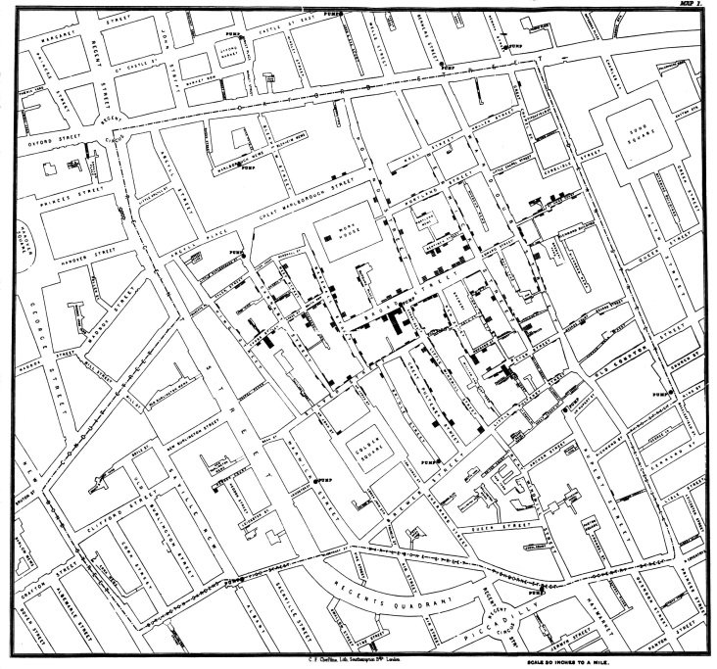

Geospatial analysis in public health
Background and concepts
The mapping of health events has a long history in epidemiology, going back at least as far as John Snow’s mapping of cholera cases in London during the 1850s
https://upload.wikimedia.org/wikipedia/commons/2/27/Snow-cholera-map-1.jpg

Slide 35
Geospatial analysis in public health
Background and concepts
Modern applications in public health continue to include mapping of disease cases, but also aim to
evaluate differences in health services and health-related rates/risk across different geographic areas
quantify uncertainty in spatial measures/maps
identify “clusters” of disease or other health events of interest
assess the significance of factors potentially related to disease occurrence (e.g., exposures, services, etc.)

Slide 36
Why do we need geospatial analysis?
Background and concepts
In public health, we often observe that measures from neighbouring regions are related (e.g., all tend to have high values, or low values) – consider Tobler’s (1970) first law of geography,
“Everything is related to everything else, but near things are more related than far things”
For accurate and reliable estimates, geospatial analysis must take proper account of this spatial dependency (non-independence) among measures

Slide 37
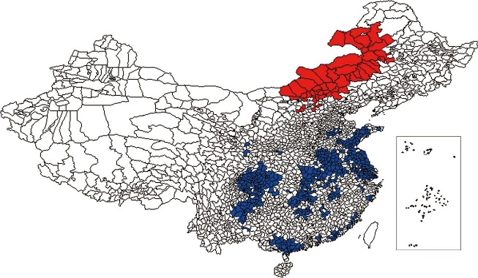
Why do we need geospatial analysis?
Background and concepts
Yet, we also observe that rates of disease often differ across locations
Spatial analysis can provide a better understanding of how and why disease varies by location, which ultimately can help inform disease prevention and control
Also, note that much of the data collected in public health has some record of location – this is important information that should be included in our analyses!

Slide 38

Considerations and cautions
Background and concepts
Many considerations must be made when conducting geospatial analysis, including
requirements, access, use and quality of data*
privacy and confidentiality
historical artifacts
appropriate analytic methodology
statistical assumptions
interpretational challenges
appropriate dissemination
Note that not all of these are covered here and that consultation with experts (e.g., medical geographer) should be standard practice
*Geospatial analysis suffers from the 4 “in’s”: data requirements are intensive, but the data themselves may be inaccessible, inaccurate, and incomplete (Albert et al., 2000)

Slide 39
Review of selected terms and concepts
Background and concepts
For your reference, see the following sources for terminology and concepts related to spatial analysis:
https://support.esri.com/en/other-resources/gis-dictionary
https://gisgeography.com/gis-dictionary-definition-glossary/
https://www150.statcan.gc.ca/n1/pub/92-195-x/92-195-x2011001-eng.htm

Slide 40
Discussion

Slide 41

Spatial analysis in public health
Discussion
How can spatial analyses inform public health decisions?
Informing service distribution, based on population characteristics, density, health care needs; or, identifying closest appropriate service for underserved communities
Measuring and evaluating distance and time to health care facilities for key populations (e.g., elderly, homeless, etc.) – straight line, relative, road network distances – to understand needs and gaps
Surveillance and monitoring of health events, including disease incidence, deaths, immunization coverage, and their longitudinal trends, by geographic regions to inform investigation and action

Slide 42
Illustrative example

Slide 43
Geospatial analysis in R
Illustrative example
Here, our focus is the application of geospatial methods using R software
NO₂ concentrations in Europe as a public health example

Slide 44
References and resources
Albert, D.P., Gesler, W.M. and Levergood, B. eds. 2003. Spatial analysis, GIS and remote sensing: applications in the health sciences. CRC Press
Tobler W. 1970. A computer movie simulating urban growth in the Detroit region. Economic Geography, 46(Supplement): 234–240.
Waller, L.A. and Gotway, C.A. 2004. Applied spatial statistics for public health data. John Wiley & Sons.

Slide 45
Break 10:30am-10:45am

Slide 46
Module 2: Working with and understanding spatial data
Michael Otterstatter, PhD
Analytic Capacity Building Initiative: Workshop in Geospatial Methods
September 17-18, 2019, Calgary, Alberta

Slide 47
Outline
Background and concepts
Spatial data
Coordinate reference systems and projection systems
Spatial data in R
Illustrative example
R script: Working with spatial data
Discussion
Challenges in accessing and using spatial data
References and other resources

Slide 48
Background and concepts

Slide 49
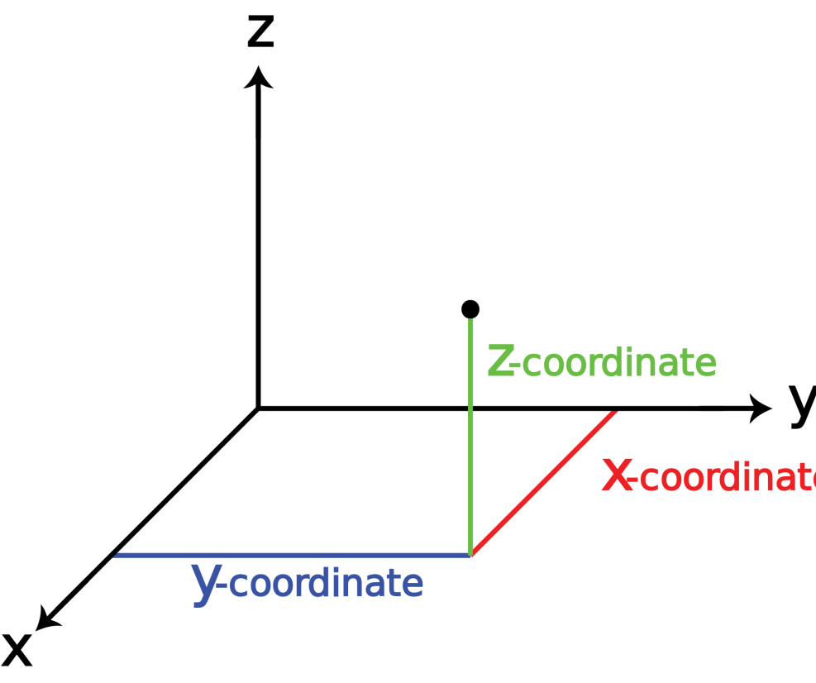
Spatial data
Background and concepts
Geospatial data are those data located in two or more dimensions – these additional dimensions provide additional information for analysis and understanding

Slide 50
Spatial data
Background and concepts
In geospatial analysis, the actual location of something is described using a georeference, typically a coordinate system
In addition to location, three essential aspects of geospatial data are
features (point, line, area or volume)
supports (size, shape and orientation of features)
attributes (characteristics or measurements associated with a feature)

Slide 51
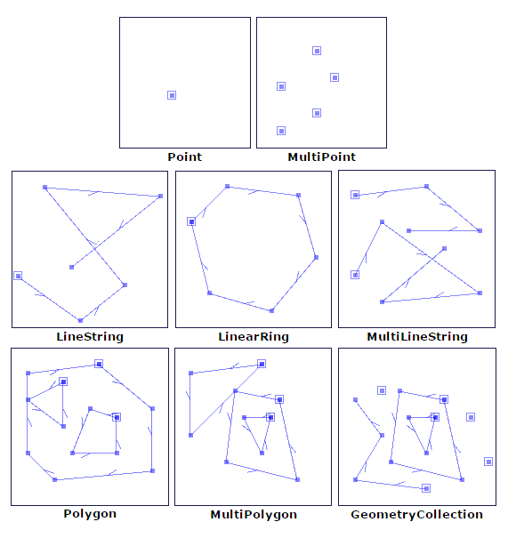
Spatial data
Background and concepts
Examples of ‘features’
Locations of residences, hospitals, services
Routes of streets, public transit, rivers
Health or census region, catchment, lake
https://automating-gis-processes.github.io/CSC/notebooks/L1/geometric-objects.html

Slide 52

Spatial data
Background and concepts
Briefly, let’s review a few aspects of geospatial data
vector and raster data
point and areal data
polygons
geocoding

Slide 53
Spatial data: vectors and rasters
Background and concepts
Vector data: representation of geographic features as points, lines, and polygons using coordinate pairs and ordered lists of vertices; attributes may be associated with each vector feature
e.g., summarised population characteristics (e.g., health, socio-demography, etc.) by census regions or other distinct boundaries
Raster data: geographic features are represented and stored as uniformly sized pixels; attributes are typically associated with each of these grid cells
e.g., satellite imagery and other remote sensing information

Slide 54
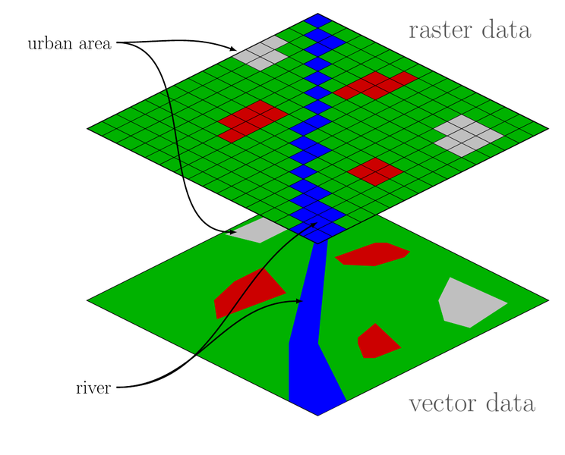
Spatial data: vectors and rasters
Background and concepts
https://commons.wikimedia.org/wiki/File:Raster_vector_tikz.png

Slide 55
Spatial data: vectors and rasters
Background and concepts
Both vector and raster data can be used together (or converted from one to the other), but vector data usually require much less computational memory and time
Here, we focus only on the manipulation, mapping and analysis of vector data

Slide 56
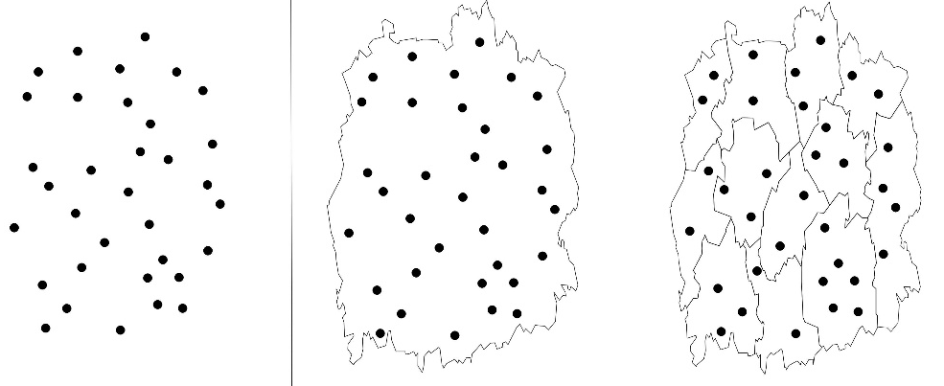
Spatial data: points vs areal units
Background and concepts
Spatial information comes in a variety of forms, with space treated as
a continuous distribution, giving rise to point data with values that can occur at any location in space (e.g., continuous measures of temperature for all points within a region); or,
aggregate, or areal, units with summary values for each unit (e.g., average temperature in a region) which may be then assigned to a representative point such as the region’s centroid

Slide 57
Spatial data: polygons
Background and concepts
In geospatial data, a polygon is a closed shape defined by a sequence of coordinate pairs (vertices) – the first and last coordinate pair are the same and all other pairs are unique
Map regions can be represented by polygons, and analyses may use a representative point (e.g., centroid) for each polygon to define its spatial location and calculate distances to other polygons or points of interest

Slide 58
Spatial data: polygons
Background and concepts
In addition to distances between polygons, we are often also interested in adjacency, i.e., whether or not two polygons share an edge or vertex

Slide 59
Spatial data: geocoding
Background and concepts
raw location is often given by an address (e.g., census unit, postal code, street address, etc.), which must be assigned, or geocoded, to a spatial location, such as lat/lon, prior to analysis
geocoding is the matching of an address to the corresponding geographical coordinates using a reference database (e.g., postal code conversion file)
geocoding is rarely perfect – several sources of uncertainty can obscure the actual location of a particular address; manual work may be needed to generate appropriate coordinates for some addresses

Slide 60
Coordinate reference systems (CRS)
Background and concepts
How do we describe locations (the ‘coordinates’) of our data on the surface of the earth?
a coordinate reference system (CRS) represents locations by coordinate pairs, indicating distance from an origin point
geographic CRS: based on latitude (degrees north/south of equator) and longitude (degrees east/west of Prime Meridian) – every point on Earth is defined by a lat-lon coordinate pair, often written in degrees, minutes, seconds (DMS) or decimal degrees (DD)
projected CRS: based on units (typically meters) from an origin point (a ‘datum’)

Slide 61



Projection systems
Background and concepts
If we simply laid flat the Earth’s curved surface, spatial locations would be warped
Instead, to display spatial information defined by coordinates, we use a transformation (projection), converting location on the Earth’s surface to a location on a flat two-dimensional map

Slide 62
Projection systems
Background and concepts
Many projection systems exist, with differing strengths/ weakness and degrees of warping
conformal - preserves spatial shape over small areas, but larger areas are distorted (e.g., ‘Mercator’)
equal area - preserves area so that relative sizes of regions are correct and comparable (e.g., ‘Albers’ equal-area’)
equidistance - preserves distance measures

Slide 63
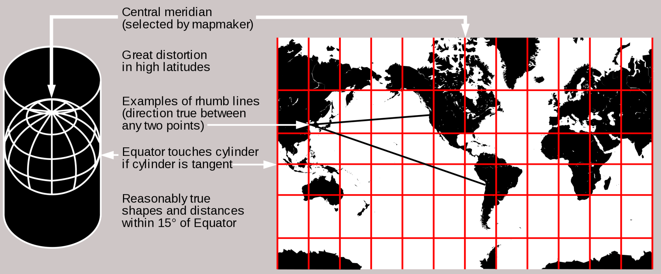
Projection systems
Background and concepts
one consequence of projecting is that scale (map distance:actual distance) is not the same across a map’s surface – reported scales are usually an average
Mercator projection
https://en.wikipedia.org/wiki/Map_projection

Slide 64
Projection systems
Background and concepts
If the purpose is only a quick map, projection of spatial data is not strictly necessary – simple display of lat-lon is adequate
However, if analyses involve measures/comparisons of distance, shape or area, a projected coordinate system should be used
Choice of the projection system depends on what aspects (e.g., distance) must be most accurately preserved

Slide 65
Challenges of spatial data
Background and concepts
Modifiable Areal Unit Problem (MAUP): appearance of false patterns resulting from the aggregation of spatial data into areal units – two aspects of MAUP
scale of aggregation: depending on size (or number) of uniform spatial units used for aggregation, summary statistics can change even though underlying data are the same
zoning: depending on shape of spatial units used for aggregation, summary statistics can change even when the number of spatial units is constant

Slide 66
Challenges of spatial data
Background and concepts
Modifiable Areal Unit Problem (MAUP)
Waller & Gotway 2004

Slide 67
Challenges of spatial data
Background and concepts
In public health, data are often aggregated into areal units (e.g., for calculating rates, ensuring privacy), making MAUP a common and important challenge
There is no perfect solution, be aware of this problem and consider its impact, e.g., how do the results change if I modify the boundaries? What statistical summaries are least impacted by the level of aggregation?

Slide 68
Challenges of spatial data
Background and concepts
Location uncertainty: aside from problems geocoding a specific address, there may still be substantial uncertainty about the appropriateness of a set of coordinates
most people are highly mobile, hence a particular address may not be representative of their location (e.g., home vs work vs recreation)
people move day-to-day (at home, on vacation, etc.) and over many years (multiple home and work addresses) making it difficult to determine accurate locations at specific times

Slide 69
Key sources of spatial data in public health
Background and concepts
health data (e.g., outcome data from routine surveillance programs, administrative health databases, as well as observational and experimental research studies), including vital statistics, reportable diseases, disease registries, national and provincial health surveys
census data (e.g., socio-demographic information collected through formal government census), including population sizes by age, sex, region, counts of housing units, employment and income profiles, education, immigration, family sizes

Slide 70
Key sources of spatial data in public health
Background and concepts
environmental data (e.g., ecological indicators and natural resources routinely monitored by government and other national/provincial organizations), including land use and related characteristics, habitats, agricultural operations and practices, bodies of water and water quality, air quality, climate
remote sensing data (e.g., aerial and satellite imagining data) including, aerial photographs, satellite measures of radiation and sea-surface temperature
other sources?

Slide 71

Considerations and cautions
Background and concepts
Interpretation of spatial data has certain challenges (modifiable areal unit problem, location uncertainty, ecologic fallacy, etc.) that must be considered carefully
Different data sources may use different projection systems – these must be reconciled before data sources can be combined for analysis
specific location information, e.g., street address or corresponding coordinates, can uniquely identify individuals -- care is needed when storing and analyzing such information and it may be necessary to mask locations to protect privacy

Slide 72
Spatial data in R

Slide 73


Background
Spatial data in R
R is a free, open-source statistical software package that can be used for all aspects of data manipulation, analysis and visualisation (https://cran.r-project.org/)
R functions (commands) are organized into packages (also called libraries) that can be loaded as needed
Most R users interface with the R program via RStudio and use command-line code (scripts)
Numerous R packages exist for working with spatial data (see: https://cran.r-project.org/web/views/Spatial.html)
Here, we focus on the new sf (‘simple features’) package (see: https://CRAN.R-project.org/package=sf)

Slide 74
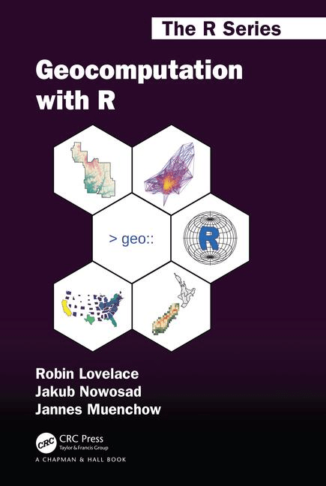
The sf package
Spatial data in R
The sf package is a collection of tools for working with spatial data in R, where ‘sf’ refers to simple features, which are a standard set of geometry types (e.g., point, line, polygon, etc.) supported by the package
sf currently supports tools for vector data only (not raster data)
use of the sf package is described extensively in the free online book Geocomputation with R (https://geocompr.robinlovelace.net/)

Slide 75
The sf package
Spatial data in R
sf data objects appear in R as standard data frames, except with addition of a geometry column containing condensed list of all coordinate information for a particular spatial feature
With a basis in standard data frames, powerful data manipulation tools of R, particularly those in the tidyverse, can be used with sf

Slide 76
The sf package
Spatial data in R
For example, we can work with sf data objects in the same way as any (tidy) data object in R, including chaining commands together (piping) with %>%, using filter to include only certain rows, select to include only certain columns, and mutate to create new derived variables:
world_asia <- world_data %>%
filter(continent == "Asia") %>%
select(name, continent) %>%
mutate(map_col = ifelse(name == “China”, “white”, “grey”))

Slide 77
The sf package
Spatial data in R
sf contains numerous functions (commands) for importing, manipulating, transforming and exporting spatial data – all have intuitive names and begin with the prefix st_
st_read reads spatial data
st_point creates spatial points
st_crs retrieves the data’s coordinate reference system
st_distance calculates Euclidean distance
etc.

Slide 78
Lunch 12:00pm-1:00pm

Slide 79
Illustrative example

Slide 80
Working with spatial data in R
Illustrative example
R script: Working with spatial data
Introducing
the sf package
spatial data operations
using sf cheatsheet

Slide 81
Discussion

Slide 82
Challenges in accessing and using spatial data
Discussion
What challenges exist for jurisdictions in accessing geospatial data?
What challenges exist for jurisdictions in working with and analyzing geospatial data?

Slide 83
References and resources
Bivand, R.S., Pebesma, E.J., Gómez-Rubio, V. and Pebesma, E.J. 2008. Applied spatial data analysis with R. New York: Springer.
Lovelace, R. 2017. Introduction to visualising spatial data in R. https://github.com/Robinlovelace/Creating-maps-in-R
Waller, L.A. and Gotway, C.A. 2004. Applied spatial statistics for public health data. John Wiley & Sons.
R materials
the sf package [https://geocompr.robinlovelace.net/spatial-class.html]
spatial data and the tidyverse [https://geocompr.github.io/geocompkg/articles/tidyverse-pitfalls.html]
spatial data operations [https://geocompr.robinlovelace.net/spatial-operations.html]

Slide 84
Break 2:30pm-2:45pm

Slide 85
Module 3: Mapping and other spatial visualizations
Michael Otterstatter, PhD
Analytic Capacity Building Initiative: Workshop in Geospatial Methods
September 17-18, 2019, Calgary, Alberta

Slide 86
Outline
Background and concepts
principles of data visualisation
review of map types
Creating basic maps in R
tmap
Illustrative example
R script: From data to map
References and other resources

Slide 87
Background and concepts

Slide 88
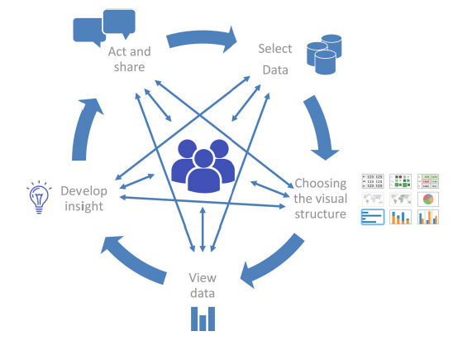
Principals of data visualization
Background and concepts
Data visualisation is
A well-known component of scientific communication, but is increasingly recognized as a process unto itself for generating insights; and,
a rapidly growing field, particularly with availability of large complex datasets and powerful viz tools
‘The visual analytics cycle’, Martinez et al. 2016

Slide 89
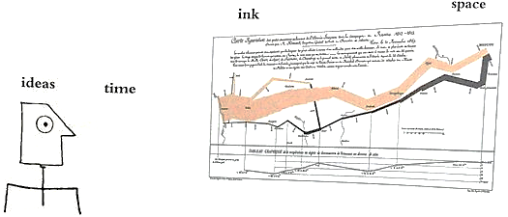
Principals of data visualization
Background and concepts
Consider a guiding principle in visualization…
“Graphical excellence gives the viewer the greatest number of ideas in the shortest time with the least ink in the smallest space…and requires telling the truth about the data”*
*Tufte, 2001.

Slide 90

Principals of data visualization
Background and concepts
…and a distinction, particular to maps, underscoring the need for accurate and effective map making:
“…maps differ from statistical graphics because the geographic setting portrayed in the map almost always triggers memories, opinions, and conclusions wholly separate from (but perhaps related to) the intent of the mapmaker”*
*Waller & Gotway, 2004.

Slide 91
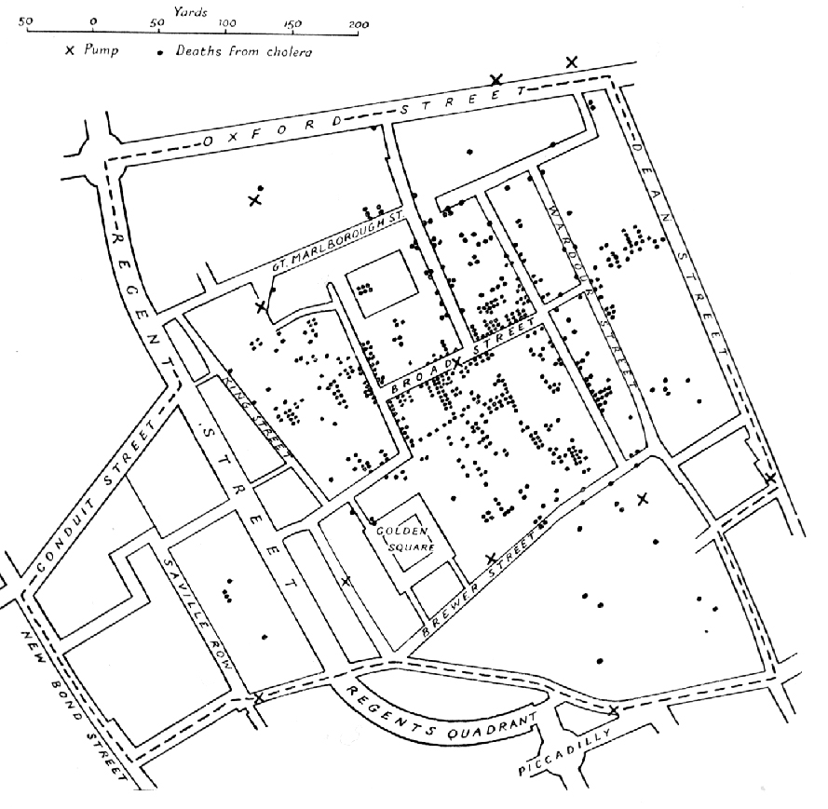
Review of map types
Background and concepts
Point features vs aggregate features
Point maps represent specific geographic locations as dots (points) on the map, e.g., residence or facility, and are primarily used to show spatial distribution
A famous public health example is John Snow’s maps of cholera cases (represented as points) – today, we often still show spatial distributions using simple dots on a map

Slide 92
Review of map types
Background and concepts
Point features vs aggregate features
Point maps can reflect a limited amount of attribute information through the use of differing symbols, and/or colours, sizes and transparencies of the points
Hence, point maps are most suitable when there is no attribute information shown, or when the attributes take on a small number of discrete values

Slide 93
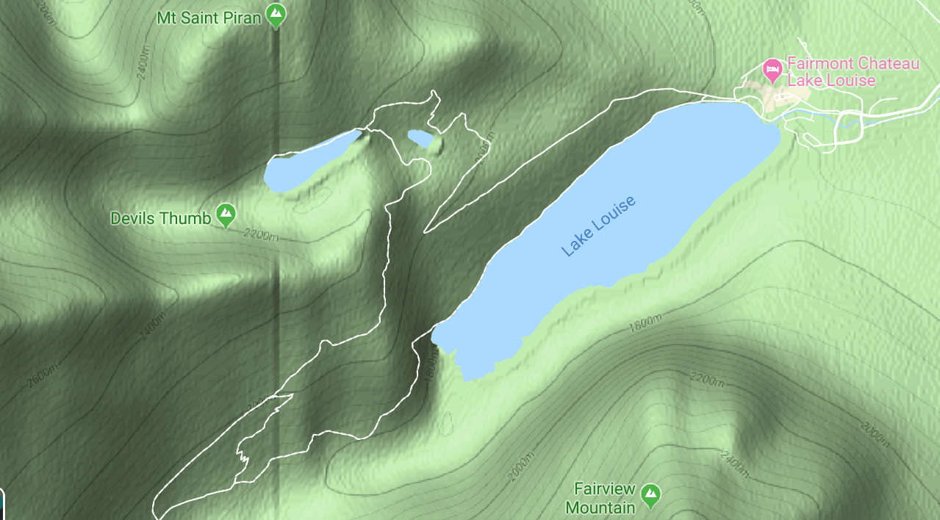
Review of map types
Background and concepts
Point features vs aggregate features
Contour maps are suitable when attribute information is a continuous range of values, e.g., topographic maps with isolines/shading to represent differing elevation

Slide 94
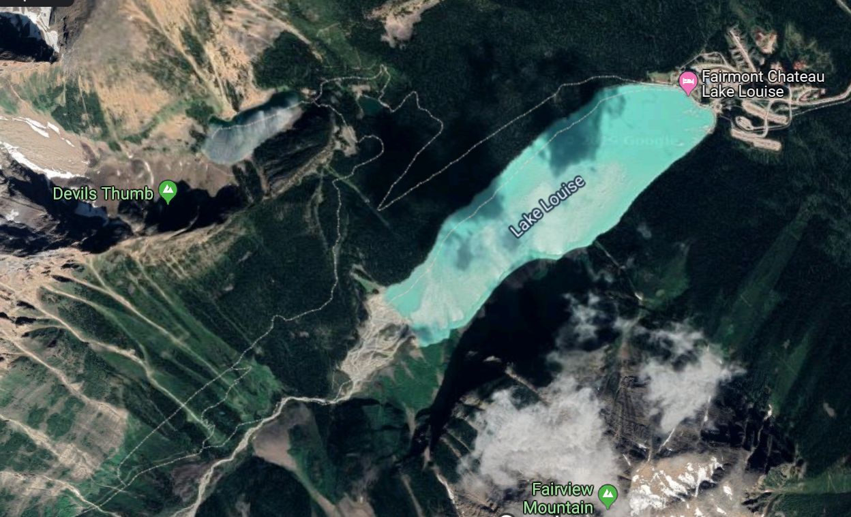
Review of map types
Background and concepts
Point features vs aggregate features
Image maps are based on pixels and variations in colour to show features, most notably aerial photographs and satellite imagery

Slide 95
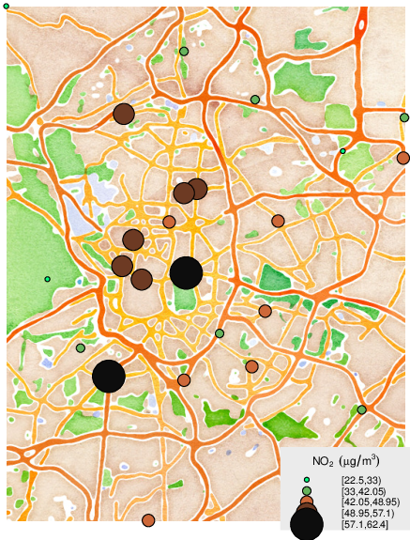
Review of map types
Background and concepts
Point features vs aggregate features
For areal data (areas and aggregations), maps use symbols, patterns or colour to represent attribute values for a region
For example, proportional symbol maps, use symbol size scaled proportionately to the value of an attribute for a given region
Lamigueiro, Ó. P. 2014

Slide 96
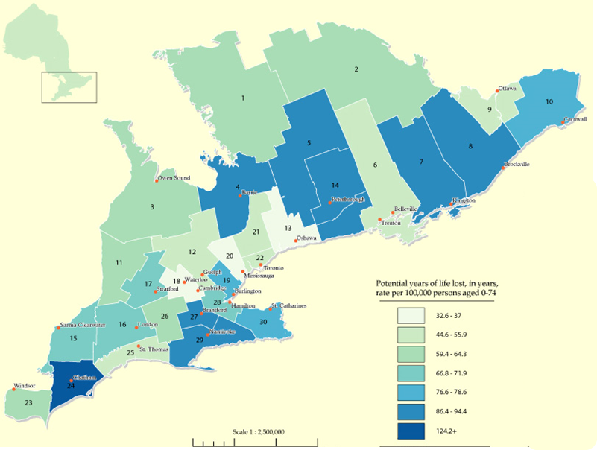
Review of map types
Background and concepts
Point features vs aggregate features
Choropleth maps display areal data by assigning colours to different attribute values and shading the regions of the map accordingly
Despite certain limitations (e.g., single colour implies constant regional rates), choropleth maps are common in public health given data are often available only as regional aggregates

Slide 97
Review of map types
Background and concepts
Point features vs aggregate features
Note that range of values shown in choropleth maps may either be defined into classes (e.g., differing colours or patterns) of non-overlapping intervals in an attribute (‘classed choropleth maps’) or show a continuous change (e.g., differing hue or intensity of a single colour)

Slide 98

Review of map types
Background and concepts
So, which type of map to use? Consider:
Any working limitation or restrictions (e.g., only black and white)
appropriateness given the data at hand (point locations vs areal data)
In general, try a few different map types and see which best communicates the message in the data

Slide 99
Review of map types
Background and concepts
Reference maps vs thematic maps
Reference maps focus on locations and names of particular features, e.g., boundaries and names of standard geographic areas, and their major physical features, such as roads, coastlines, and bodies of water
Thematic maps focus on spatial variation in one or a few specific topics or ‘themes’ -- common types of thematic maps show distributions of population density or average income
* Also see: www150.statcan.gc.ca/n1/pub/92-195-x/92-195-x2011001-eng.htm4

Slide 100
Review of map types
Background and concepts
Reference maps vs thematic maps
Note that reference maps and thematic maps are not mutually exclusive: thematic maps typically contain some reference information, e.g., place names or roads, to help orient readers to the regions shown on the map

Slide 101
Review of map types
Background and concepts
Reference maps vs thematic maps
Thematic maps contain two key elements: i) a base map and ii) statistical data
Both elements usually come from digital files, e.g., cartographic boundary files and census data
often thematic maps are point maps or choropleth maps
thematic maps have a variety of purposes, including presentation of geographic data and exploratory spatial data analysis

Slide 102

Considerations and cautions
Background and concepts
Accurate and effective mapping is a careful balance of communicating a message and honest visualization of the data – a map cannot show everything, but it must accurately reflect the signal in the data
Aesthetics (i.e., those aspects or principles concerned with perceptual value or beauty) are not covered here, but can be essential for accurate and effective communication with maps

Slide 103
Creating basic maps in R

Slide 104
Background
Creating basic maps in R
Maps are one of the most fundamental and effective communication tools, and form the basis of geospatial analysis
Map making is now more accessible through powerful and user-friendly software, such as R
Although it is now easy to jump in and make maps, give careful attention to the accuracy and effectiveness of your maps as communication tools

Slide 105
Background
Creating basic maps in R
Here, we focus on the R package tmap for modern, flexible mapping. For information on tmap see
https://cran.r-project.org/web/packages/tmap/ and
https://cran.r-project.org/web/packages/tmap/vignettes/tmap-getstarted.html
The applications of tmap herein follow Lovelace et al. https://geocompr.robinlovelace.net/adv-map.html

Slide 106
Background
Creating basic maps in R
Static maps
Base R function plot() accepts vector and raster data and produces static maps quickly and simply; however, it is often not flexible enough
R package tmap()is a set of tools for creating thematic maps from vector or raster data
maps can be static or interactive maps
Syntax is concise, easy to learn, and works well with essential data manipulation tools in tidyverse

Slide 107
tmap
Creating basic maps in R
like the primary plotting package in R (ggplot2), tmap is based on the principles of layer grammar of graphics (Wilkinson, 2012)
Essentially tmap generates maps from a spatial dataset by forming one or more layers that each associate specific visual characteristics of map elements (‘aesthetics’, such as position, colour, size, transparency, etc.) with data variables

Slide 108
tmap
Creating basic maps in R
To create a map, one uses the tm_shape() function plus (+)
one or more aesthetic layers, e.g., tm_polygon, tm_fill, tm_symbol, etc.
tm_shape(my_sf_data) +
tm_polygon(col = “my_regions”)
tm_shape() specifies the sf spatial data object, whereas the layers specify how data variables are assigned to visual map elements (aesthetics).

Slide 109
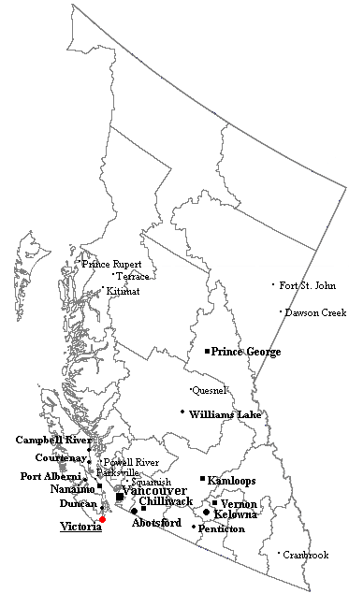
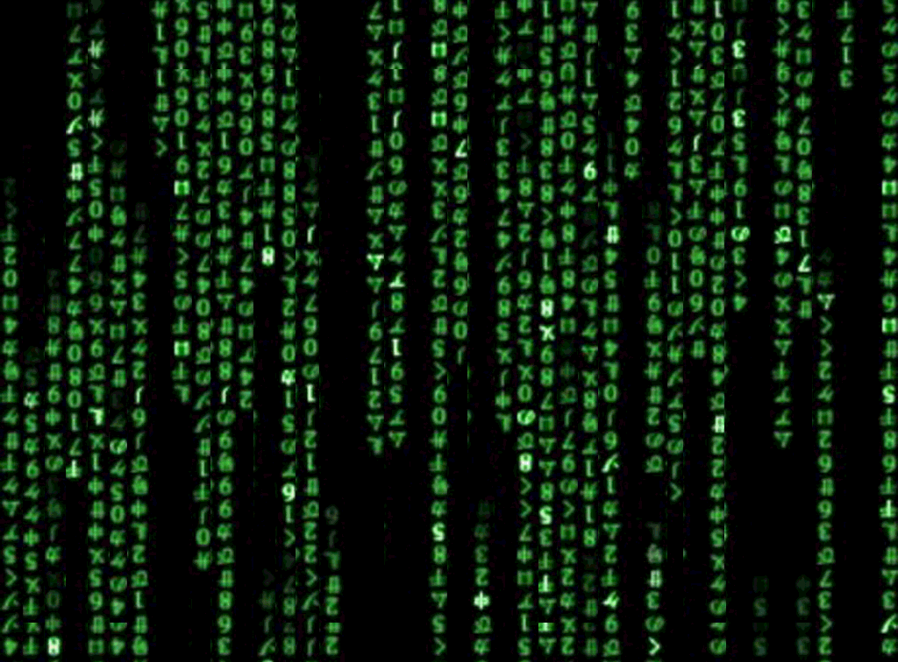
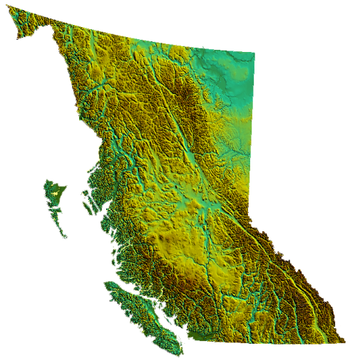
dataset_a
Layer A [aesthetics: borders]
Layer B [aesthetics: point locations]
tm_shape(dataset_a) + tm_polygons() + tm_symbols()
dataset_b
Layer C [aesthetics: geography]
tm_shape(dataset_b) + tm_fill()

Slide 110
tmap
Creating basic maps in R
To see a list of the aesthetic layers that are available in tmap, type help(“tmap-element”)
In order to generate a quick and simply thematic map, one can also use qtm(my_sf_data)

Slide 111
tmap
Creating basic maps in R
In R, we typically assign data, variables, plots and all other things as ‘objects’. Similarly, working with and saving maps is made easier by creating them as objects
my_base_map <- tm_shape(my_sf_data) + tm_polygon() (e.g., starting with borders)

Slide 112
tmap
Creating basic maps in R
New layers can then be added successively:
new_map1 <- my_base_map +
tm_shape(more_sf_data) +
tm_raster() (e.g., adding elevation)
new_map2 <- new_map1 +
tm_shape(even_more_sf_data) +
tm_lines() (e.g., adding bodies of water)

Slide 113
tmap
Creating basic maps in R
Note that tmap() automatically uses certain default aesthetics (e.g., black lines, grey shading for fills, etc.), but that these are all modifiable in their associated layer.
There are two types of aesthetics: i) static aesthetics – set visual aspect of map element to a constant value; ii) variable aesthetics – set visual aspects to vary according to values in the dataset
tm_shape(my_sf_data) +
tm_fill(col = “red”)
tm_shape(my_sf_data) +
tm_fill(col = “my_landarea_variable”)

Slide 114
tmap
Creating basic maps in R
Aesthetics include elements such as colour (col =), transparency (alpha =), line width (lwd =), line type (lty =), title (title =), etc.

Slide 115
Summary of Day #1

Slide 116
Workshop in Geospatial Methods
Michael Otterstatter , Nicolette Baines & Zahra Sayyed
Sept 18th, 2019

Slide 117
Module 3: Mapping and other spatial visualizations
Michael Otterstatter, PhD
Analytic Capacity Building Initiative: Workshop in Geospatial Methods
September 17-18, 2019, Calgary, Alberta

Slide 118
Illustrative example

Slide 119
Mapping census data
Illustrative example
R script: From data to map
Introducing
mapping using tmap
using the tmap cheatsheet
using the R color cheetsheet

Slide 120
References and resources
Lamigueiro, Ó. P. 2014. Displaying time series, spatial, and space-time data with R. Chapman and Hall/CRC.
Martinez, R., Ordunez, P., Soliz, P. N., & Ballesteros, M. F. (2016). Data visualisation in surveillance for injury prevention and control: conceptual bases and case studies. Injury prevention, 22(Suppl 1), i27-i33.
Tufte, E.R. 2001. The visual display of quantitative information (Vol. 2). Cheshire, CT: Graphics press.
Waller, L.A. & Gotway, C.A. 2004. Applied spatial statistics for public health data. John Wiley & Sons.
Wilkinson, L. 2012. The grammar of graphics. In Handbook of Computational Statistics (pp. 375-414). Springer, Berlin, Heidelberg.

Slide 121
Module 4: Descriptive analysis and identification of hotspots
Michael Otterstatter, PhD
Analytic Capacity Building Initiative: Workshop in Geospatial Methods
September 17-18, 2019, Calgary, Alberta

Slide 122
Outline
Background and concepts
Clustering and detection of clusters
Global spatial autocorrelation
Local spatial autocorrelation
Cluster detection methods
Illustrative example
R script: Descriptive analysis and spatial autocorrelation
R script: Detecting spatial clusters
References and other resources

Slide 123
Background and concepts

Slide 124
Clustering and detection of clusters
Background and concepts
Public health data are often available by administrative regions, as opposed to point locations, for example:
census geographies: e.g., subdivisions or dissemination areas
postal code areas: e.g., forward sortation areas and 6-digit postal codes
Here, we consider measurement of clustering and detection of clusters in data organized and aggregated into administrative regions
We make use of corresponding population sizes, for calculation of rates (events/population) and expected numbers of events in a region
Recall relevant cautions: e.g., ecologic fallacy, modifiable areal unit problem (MAUP), and trade-off between resolution and sample size

Slide 125
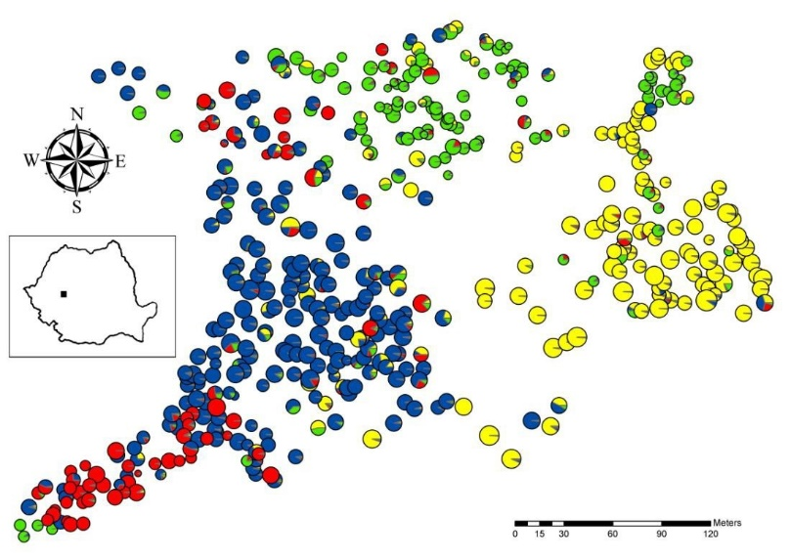

Clustering and detection of clusters
Background and concepts
With clustering, we are interested in measuring if, and how much, events are aggregated in space across an area of interest (global patterns)
With detection of clusters, we are interested in identifying specific regions that form an unusual spatial aggregation of events (local patterns)

Slide 126
Clustering and detection of clusters
Background and concepts
Measures of spatial autocorrelation are often used to
describe spatial patterns of events across an entire study area (global spatial autocorrelation – a measure of clustering), or
provide an indication of each region’s similarity (in events) to its neighbouring regions (local spatial autocorrelation – detection of clusters)
Many measures of global and local spatial autocorrelation exist, but they tend to have a common formulation

Slide 127
Break 10:30am-10:45am

Slide 128
Global spatial autocorrelation
Background and concepts
The common calculation of global spatial autocorrelation is the cross-product of two matrices:
values of similarity (in event counts) between each pair of regions; and,
values indicating proximity (distance, neighbouring, etc.) between each pair of regions
high cross-product values (similar regions close together) indicate positive spatial autocorrelation
small values (dissimilar regions close together) indicate negative spatial autocorrelation

Slide 129
Global spatial autocorrelation
Background and concepts
Positive spatial autocorrelation Spatial randomness Negative spatial autocorrelation

Slide 130
Global spatial autocorrelation
Background and concepts
One of the most common measures of global spatial autocorrelation is Moran’s I, which is a spatially weighted version of the standard Pearson’s correlation coefficient
Global Moran’s I statistic

Slide 131
A note on spatial proximity
Background and concepts
Calculating spatial autocorrelation requires a measure of proximity between each pair of regions (spatial weight matrix or spatial proximity matrix)
Proximity values may be
pairwise distances between regions, or
binary indictors (0/1) of whether or not two regions are considered neighbours (e.g., sharing a border, within a defined distance, within the set of k nearest regions, etc.), or
weights to reflect relative importance of each neighbour (e.g., assign a weight of 1/5 to each of the five neighbours of a particular region)

Slide 132
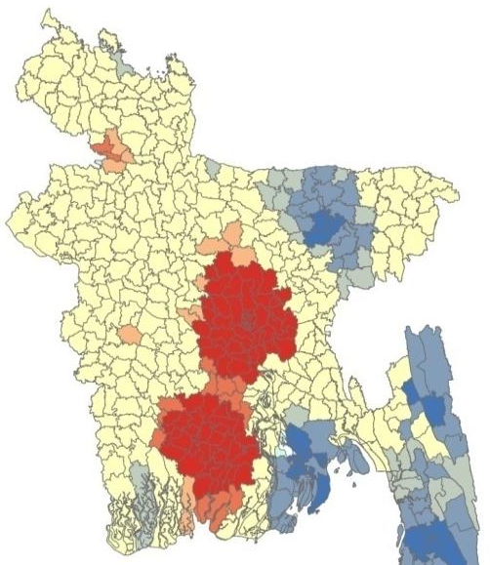
Local spatial autocorrelation
Background and concepts
Global autocorrelation does not detect clusters per se, so we utilize local measures of spatial autocorrelation to find aggregations of events
Local measures indicate each region’s similarity to its neighbours (e.g., in event counts)
Often we map local measures of spatial autocorrelation to assist in the detection of ‘hotspots’ or ‘cold spots’ in an event of interest

Slide 133
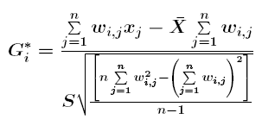
Local spatial autocorrelation
Background and concepts
As before, calculations of local metrics use similarity between a region and its neighbours, weighted by proximity of those neighbours
Common local measures of spatial autocorrelation include local Moran’s I and Getis-Ord G
Local Getis-Ord G_{i}* statistic

Slide 134
Cluster detection methods
Background and concepts
Many methods exist for cluster detection (see Fotheringham and Rogerson, 2008) – here we only introduce scan statistics as an illustration of concepts and methodology
a spatial scan can be used identify groups of events in a study area that are statistically unlikely (given the null hypothesis of no clustering) and test whether and to what degree these groups are statistically significant
spatial scans are the foundation of the freely available software package SaTScan: https://www.satscan.org/)

Slide 135
Cluster detection methods
Background and concepts
Several spatial scan statistics exist -- For regional event counts, the general methodology is:
spatial scan creates expanding circles on locations within the study area, ranging from smallest inter-centroid distance to specified upper bound (based on distance or population size)
regions with centroids falling within circle have their events (and population sizes) included in analysis of that circle
For each circle, observed and expected event counts are compared inside vs outside
the circle with the greatest risk (inside compared to outside) is deemed the ‘most likely cluster’ and statistical tests of this cluster are done using simulation methods

Slide 136
Cluster detection methods
Background and concepts
Note, we can also use ellipses or user-specified scanning windows, rather than circles, in the spatial scan – these may be preferred depending on the shape of the study area and the distribution of events
Similar scanning methods may also be extended to test for temporal and spatio-temporal clusters of events

Slide 137

Considerations and cautions
Background and concepts
Statistical clusters of events may or may not be relevant to public health – the definition of a cluster should be discussed on a case by case basis
Statistical considerations, including corrections for multiple comparisons, need to be examined carefully when performing cluster detection

Slide 138
Lunch 12:00pm-1:00pm

Slide 139
Illustrative example

Slide 140
Spatial autocorrelation in R
Illustrative example
R script: Descriptive analysis and spatial autocorrelation

Slide 141
Detecting spatial clusters in R
Illustrative example
R script: Detecting spatial clusters

Slide 142
References and resources
Fotheringham, A.S. and Rogerson, P.A., eds. 2008. The SAGE handbook of spatial analysis. Sage.

Slide 143
Looking Ahead: Joint Analytic Project
Nicolette Baines & Zahra Sayyed
Sept 18th, 2019

Slide 144
Joint Analytic Project: Purpose
The purpose of the Joint Analytic Project is to use geospatial methods and tools to better understand a key issue in colorectal cancer screening among underscreened populations. This work will provide critical information that can help develop solutions to reduce disparities.
Notes:
This project will be running between early October 2019 to the end of March 2020.

Slide 145

Joint Analytic Project: Outcomes
Chance to solidify the learnings of the workshop in a real-life application
Collaboration
Learning from other participants
Data and Analytics Expert as a resource to answer questions
Can support existing work that is being done by screening programs
I.e. use of geospatial maps for annual reports, visuals to support decision making/new initiatives, etc.

Slide 146
How the Partnership Plans to Use this Data
Joint Analytic Project Data
Joint Analytic Project Data
Program Packs
CPAC Reporting/
Tools
Community Engagement EOI
Notes:
Program Packs
Provide an overview of what disparities look like across Canada
Community Engagement
Leverage local/community level data to support discussions with community partners/key decision makers
CPAC Tools/Reporting
- Could feed in to broader reporting/tools

Slide 147
Objectives
To discuss key topics in colorectal cancer screening among underscreened groups
To discuss challenges with the data that is available in each jurisdiction
To identify feasible questions that can be addressed through a joint analytic project

Slide 148
Mentimeter
Notes:
Menti questions for each individual to answer (10 minutes)
Menti questions working in Pairs (10 minutes) – Brainstorm session, where participants will work in pairs and share their responses via Mentimeter
Code: 56 66 00

Slide 149
Instructions for using Mentimeter
Using your laptop or smartphone please visit www.menti.com
Click “Submit” after entering the code

Slide 150
Report Back
Notes:
Report Back (10 minutes)
Each pair reports back what types of questions would be feasible to answer, given the data that is available in their jurisdiction
Pairs share their answer on Mentimeter and provide their rationale to the full group

Slide 151
Discussion
Notes:
Facilitators will draw out themes in terms of the types of questions a joint analytic project can help address (10 minutes)
What is the capacity in your jurisdiction to take on this type of project? (i.e. would other departments be involved, current workload, etc.)

Slide 152

Joint Analytic Project Webinar
Bringing together the analyst folks who understand the data with the program leads who are developing and implementing approaches to address disparities
Notes:
Bringing together the analyst folks who understand the data with the program leads who are developing and implementing approaches to address disparities
Webinar will be held in early Oct
Looking to scope out what key questions in colorectal cancer screening among underscreened populations would be important to better understand and feasible to analyze with the data that is available in your jurisdiction

Slide 153
Break 2:30pm-2:45pm

Slide 154
Module 5: Describing changes in spatial patterns over time
Michael Otterstatter, PhD
Analytic Capacity Building Initiative: Workshop in Geospatial Methods
September 17-18, 2019, Calgary, Alberta

Slide 155
Outline
Background and concepts
including time in a spatial analysis
maps with a time component
Analysis of space-time data
Cluster detection with a time component
Illustrative example
R script: Adding to time to spatial analysis and visualization
R script: Adding time to cluster detection
References and other resources

Slide 156
Background and concepts

Slide 157
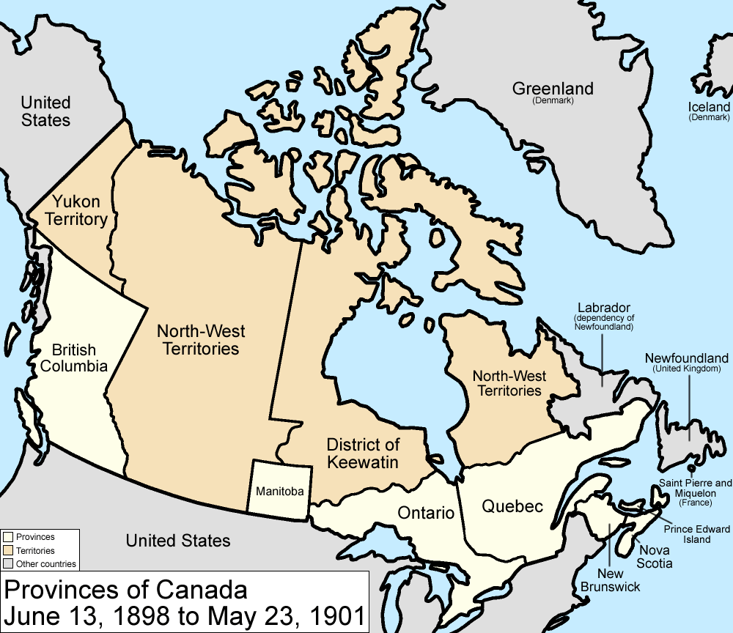
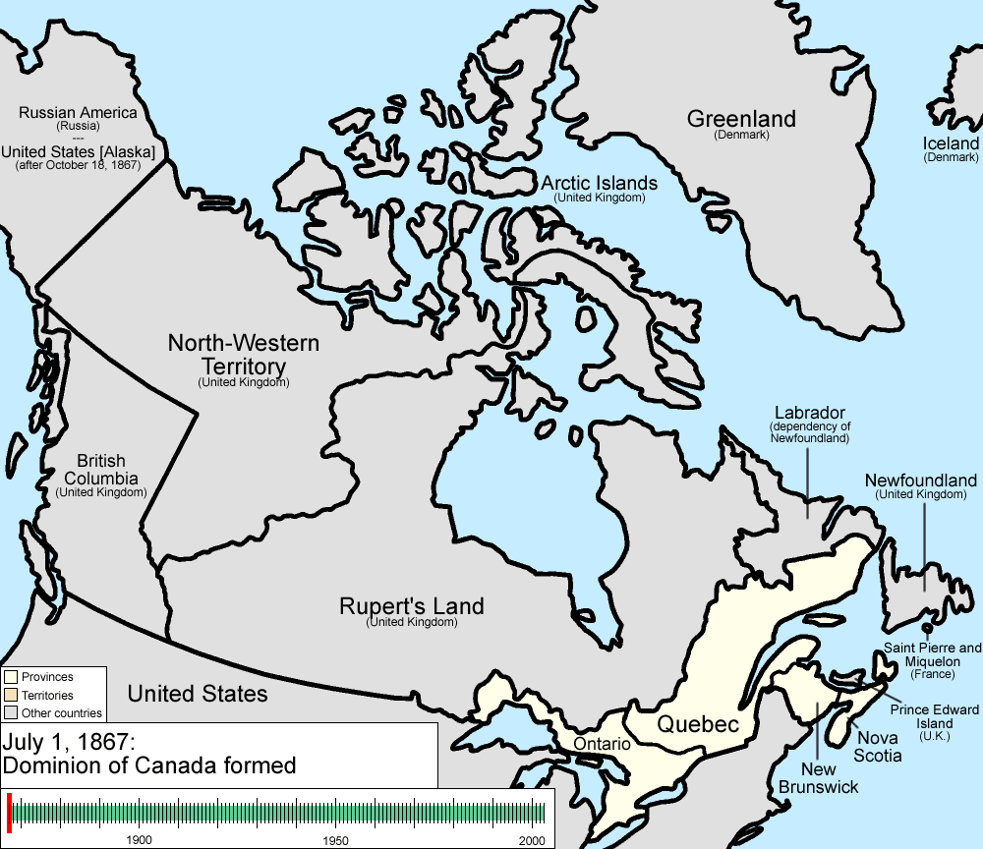
Including time in a spatial analysis
Background and concepts
Often, time is ignored in a spatial analysis -- we examine patterns in observations across locations but typically do not distinguish when these observations occurred
This is appropriate in many cases, but does not allow us to understand changes in spatial pattern over time
https://en.wikipedia.org/wiki/File:Canada_provinces_evolution_2.gif

Slide 158
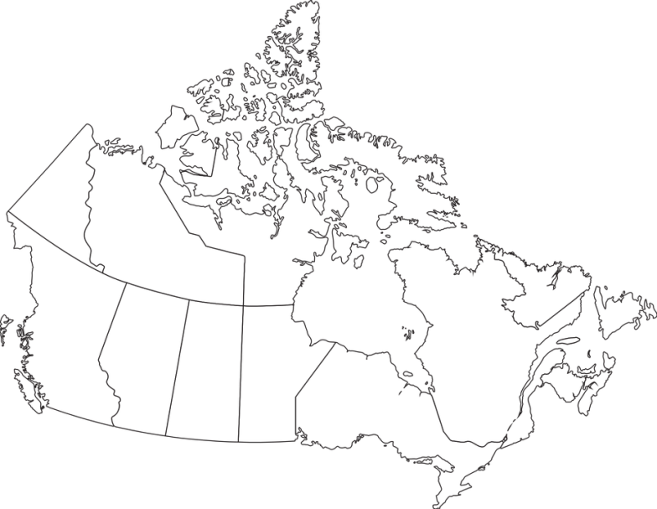


Including time in a spatial analysis
Background and concepts
Note that with the addition of time to spatial data, several data types become possible, including observations with:
location but no duration (e.g., birth or death)
both location and duration, but no movement (e.g. address of a hospital)
duration and movement (e.g., a person’s location/residence over time)
Appropriate analysis and visualization will depend on which type(s) of data we have

Slide 159
Including time in a spatial analysis
Background and concepts
A simple way to include time in our analysis is to imagine a data set of observations at n fixed locations, each of which has values for t time points
note, the locations and time points need not be regularly spaced units
Location | Time 1 | Time 2 | Time 3 | . | . | . | t
1
2
3
4
.
.
.
n

Slide 160
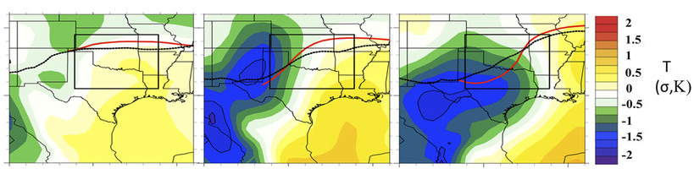
Maps with a time component
Background and concepts
One visualisation of these data is the multi-panel plot (also call facetted, or lattice, plot)
each panel represents a time point (snapshot) at a particular location (defined by spatial x and y axes)
all panels use a common x axis, y axis and legend
or, the x and y axes could represent time and value, respectively, and the panels represent spatial locations
Time 1 Time 2 Time 3

Slide 161
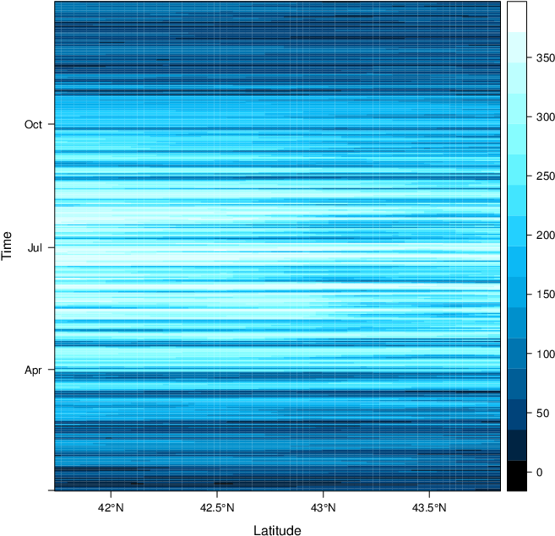
Maps with a time component
Background and concepts
Another visualisation is the pure space-time plot
spatial location is shown on the x axis, time on the y axis
value at a particular location and time is represented by an aesthetic property such as colour (e.g., darker shades represent larger values)
https://oscarperpinan.github.io/spacetime-vis/spacetime.html

Slide 162
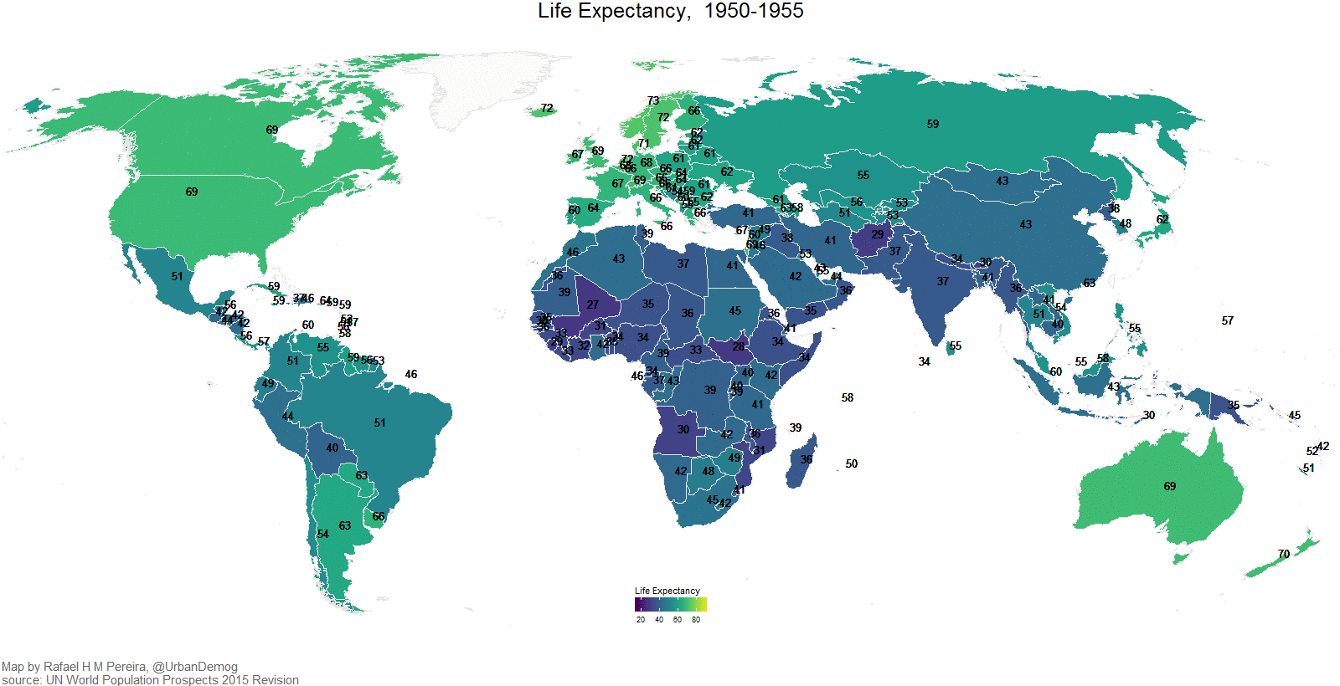
Maps with a time component
Background and concepts
Finally, an animated map can be used to effectively communicate both spatial and temporal information
can be static or interactive (similar to non-animated maps)

Slide 163

Considerations and cautions
Background and concepts
Standardization of axes and legends is essential for comparability in multi-panel plots
More generally, certain aesthetics become important when showing changes over time (e.g., appropriate and consistent scale, symbology and colouring), but are not be reviewed in detail here

Slide 164
Space-time cluster detection

Slide 165
Background
Space-time clusters
Literature on analysis of space time data often concerns the building and evaluation of statistical models (e.g., complex regressions)
Here, we consider only one particular application: detecting clusters in space and time
A more comprehensive treatment of space-time modeling is given by Wikle et al., 2019

Slide 166
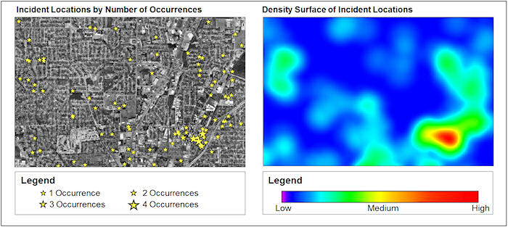
Cluster detection with a time component
Space-time clusters
Detecting spatial clusters over time is a common motivation to include time in a spatial analysis
We may be interested in
finding clusters that are localized not just in space, but also in time (e.g., elevated event counts in a certain neighbourhood but only for a certain period)
monitoring an area for changes in patterns of spatial autocorrelation, perhaps suggesting newly emerging hotspots or coldspots
https://blog.hexagongeospatial.com/wp-content/uploads/hotspot-density-surface.jpg

Slide 167
Illustrative example

Slide 168
Adding time to spatial analysis
Illustrative example
R script: Adding to time to spatial analysis and visualization

Slide 169
Detecting space-time clusters
Illustrative example
R script: Adding time to cluster detection

Slide 170
References and resources
Fotheringham, A.S. and Rogerson, P.A., eds. 2008. The SAGE handbook of spatial analysis. Sage.
Lamigueiro, Ó.P., 2014. Displaying time series, spatial, and space-time data with R. Chapman and Hall/CRC.
Wikle, C.K., Zammit-Mangion, A., and Cressie, N. (2019). Spatio-Temporal Statistics with R. Chapman & Hall/CRC, Boca Raton, FL.

Slide 171
Module 6: Overview of spatial modeling
Michael Otterstatter, PhD
Analytic Capacity Building Initiative: Workshop in Geospatial Methods
September 17-18, 2019, Calgary, Alberta

Slide 172
Outline
Background and concepts
purpose of spatial modeling
types spatial regression models
structure of spatial regression models
applications of spatial regression models
References and other resources

Slide 173
Background and concepts

Slide 174

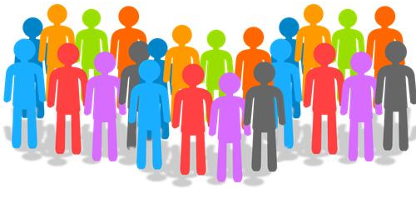


Purpose of spatial modeling
Background and concepts
Often, we wish to understand how various types of spatial information are related
outcomes
population size
individual and population characteristics
environmental exposures

Slide 175
Purpose of spatial modeling
Background and concepts
Spatial modeling provides statistical tools for
assessing how spatial distribution of health events is associated with the spatial distribution of exposures
adjusting maps and other visualizations according to available covariate information
predicting outcomes of interest based on available covariates
Here, we review only selected concepts in spatial modeling but do not cover technical aspects of model building and validation

Slide 176
Types of spatial regression models
Background and concepts
A primary type of spatial model is the spatial regression model, which adds key spatial elements to non-spatial regression models:
adjacency (neighbourhood relationships)
spatial correlation
Spatial regressions include the primary model types used in non-spatial analysis
general linear models (ordinary linear regression)
generalized linear models (Poisson and logistic regressions)

Slide 177
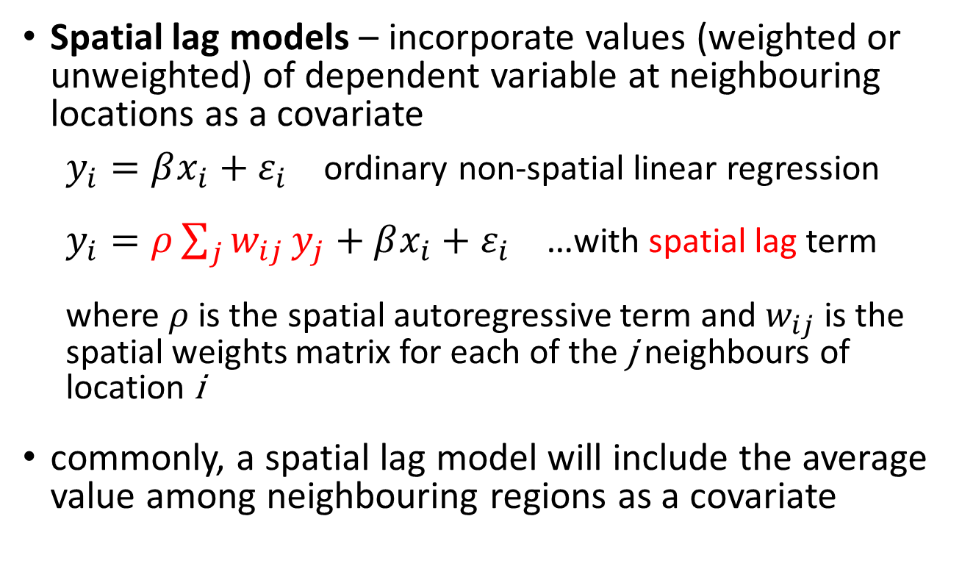
Structure of spatial regression models
Background and concepts
Spatial lag models – incorporate values (weighted or unweighted) of dependent variable at neighbouring locations as a covariate
$y_{i}=βx_{i}+ε_{i}$ ordinary non-spatial linear regression
$y_{i}=ρ\sum_{j}{w_{ij}}y_{j}+βx_{i}+ε_{i}$ …with spatial lag term
where $ρ$ is the spatial autoregressive term and $w_{ij}$is the spatial weights matrix for each of the j neighbours of location i
commonly, a spatial lag model will include the average value among neighbouring regions as a covariate

Slide 178
Structure of spatial regression models
Background and concepts
Spatial lag models are useful as regressions that account for spatial autocorrelation (by filtering out the spatial autocorrelation among neighbours)

Slide 179
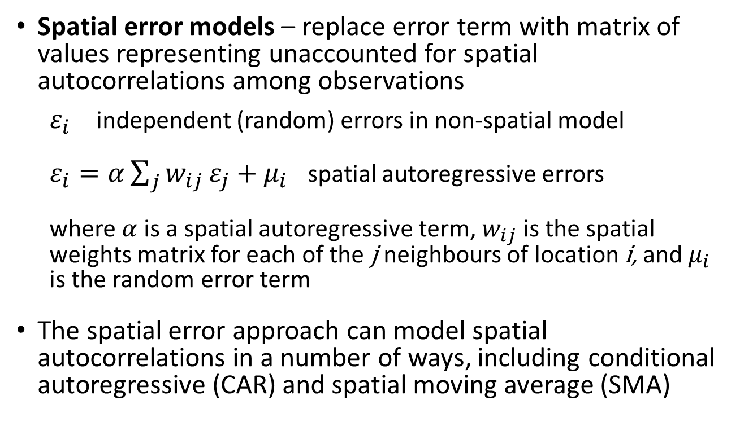
Structure of spatial regression models
Background and concepts
Spatial error models – replace error term with matrix of values representing unaccounted for spatial autocorrelations among observations
$ε_{i}$ independent (random) errors in non-spatial model
$ε_{i}=α\sum_{j}{w_{ij}}ε_{j}+μ_{i}$ spatial autoregressive errors
where$α$is a spatial autoregressive term, $w_{ij}$is the spatial weights matrix for each of the j neighbours of location i, and $μ_{i}$ is the random error term
The spatial error approach can model spatial autocorrelations in a number of ways, including conditional autoregressive (CAR) and spatial moving average (SMA)

Slide 180
Structure of spatial regression models
Background and concepts
Spatial autoregressive models can be implemented in R using the spdep package, similar to ordinary linear models with the lm function in base R
lm(events ~ var1 + var2, data = my_data)
lagsarlm(events ~ var1 + var2, data = my_data, listw = my_spatial_weights)

Slide 181
Applications of spatial regression models
Background and concepts
Disease mapping, adjusted for covariates (e.g., population size and structure)
Risk assessment – identifying areas of unusually high or low rates, given background distribution of covariates (e.g., sociodemographics)
Stabilization/interpolation of rates for areas with small counts or missing values
Spatial epidemiology – identifying and understanding causal (or at least associational) relationships, e.g., key drivers of spatial distribution of health events
Others?

Slide 182

Considerations and cautions
Background and concepts
It is important to conduct standard diagnostic tests of model assumptions (e.g., analysis and plotting of residuals) for spatial regressions, plus inspection of spatial patterns in residuals
Covariates in spatial regression models must be interpreted carefully – spatial variation in an outcome may be due to spatial variation in predictors and/or inherent spatial variation in the outcome itself

Slide 183
References and resources
Banerjee, S., 2016. Spatial data analysis. Annual Review of Public Health, 37: 47-60.
Fotheringham, A.S. and Rogerson, P.A., eds. 2008. The SAGE handbook of spatial analysis. Sage.
Waller, L.A. and Gotway, C.A. 2004. Applied spatial statistics for public health data. John Wiley & Sons.

Slide 184
Summary of Day #2

Slide 185
Next Steps

Slide 186
Next Steps
Online collaborative space that will house workshop materials
Audio recordings, presentations, additional resources
Participants can connect with Michael for on-going support with geospatial analysis
- Support will be provided until March 2020
Joint Analytic Project Webinar
Will occur early October 2019
Post-workshop evaluation will be emailed
by Sept 18th, 2019
Notes:
Analytic Capacity Building Webinar (early October)
Invitees: Workshop participants and NCCSN members who have decision-making ability for a colorectal screening program.
Objective: Scoping out the Joint Analytic Project based on workshop participants insights from the facilitated group discussion and feedback from screening program leads
Preparation for the webinar, have internal conversation, use worksheet to guide that

Slide 187
Questions?

Slide 188





